Slide 1
Universite De Bourgogne Centre Universitaire Condorcet
Course :
Scene Segmentation and Interpretation
Project presentation:
Machine Learning in Python
Prepared by:
Fatai Olarinde JIMOH
Lateef Olalekan ADERINOYE
Supervisor:
Dr. Guillaume Lemaitre
Date: 28th of April, 2021.

Slide 2
PROJECT CONTENT
Introduction
Methodology
Classification Techniques
KNearest Neighbor Classifier
Decision Tree Classifier techniques
Results and Analysis
Conclusion

Slide 3
ABSTRACT
Classification is a data mining (machine learning) technique used to predict group membership for data instances. There are several classification techniques that can be used for classification purpose. In this paper, we present practical application of two classification techniques: decision tree classifier and k-nearest classifier.

Slide 4
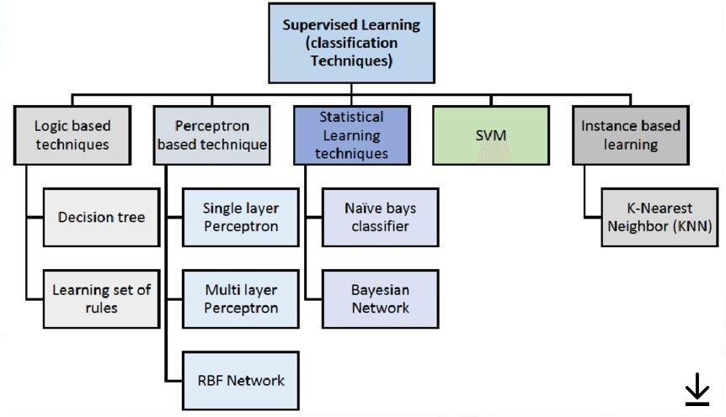
INTRODUCTION
Machine Learning Classification Technique is categorized as one of the supreme studied problems by researchers of the machine learning and data mining fields. The image depicts general model supervised learning (classification techniques).

Slide 5
METHODOLOGY
A literature search was done from articles, journals and datasets using databases such as Kaggle, google scholar, and some related web pages. The articles that contains relevant data about classification techniques applications particularly, K-Nearest Classifier and Decision Tree Classifier were mainly used to assist our project because we only focused on its usefulness to retrieve results from our features and target.

Slide 6
The Classification Techniques used for prediction
Decision Tree Classifier
The core objective of decision tree is to produce a model that calculates the value of a required variable based on numerous input variables.
KNearest Neighbor Classifier
In K-nearest neighbor (KNN) technique, nearest neighbor is measured with respect to value of k, that define how many nearest neighbors need to be examine to describe class of a sample data point

Slide 7
Results and Analysis
We looked into classification of Students Performance using K-Nearest Neighbor Classifier and Decision Tree classification models. After fitting and application of the two model for predictions, we try to compare the predictions with the main dataset for better understanding and best model performance.

Slide 8
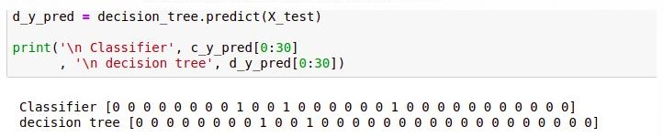
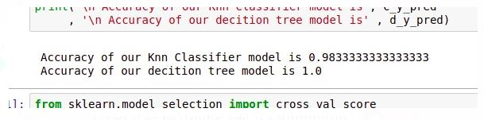
Score Accuracy for the two Models
The two models proved to perform brilliantly as Knn Classifier model accuracy result is 0.9833333333333333 and Accuracy of Decision Tree model is 1.0.

Slide 9
conclusion
Our selection of classification models (KNearest Neighbor Classifier and Decision Tree Classifier) was based on interest and intention to exposed students like us to advantage and simplicity of these two models.

Slide 10
THANK YOU.

